Slide 1
Cornerstone City Church Peninsula Plus Community Hoo Are Ya
11th May 2025

Slide 2


Slide 3


Slide 4


Slide 5
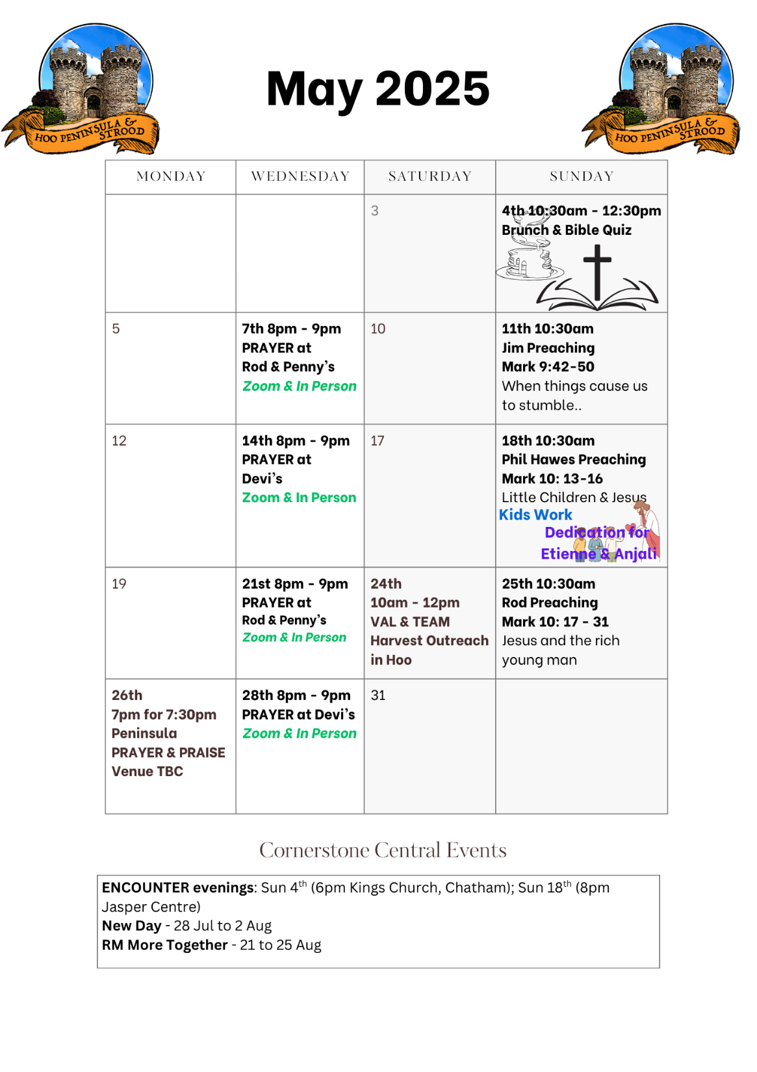

Slide 6

Grow Group 1
On YOUR MARK!

Slide 7
Leaders
Leaderss
Phil & Kim
Maria (Mia) Warren
Matthew Harrison
Richard & Elisha Acheampong
Phil & Kim
Maria (Mia) Warren
Matthew Harrison
Richard & Elisa Acheampong

Slide 8
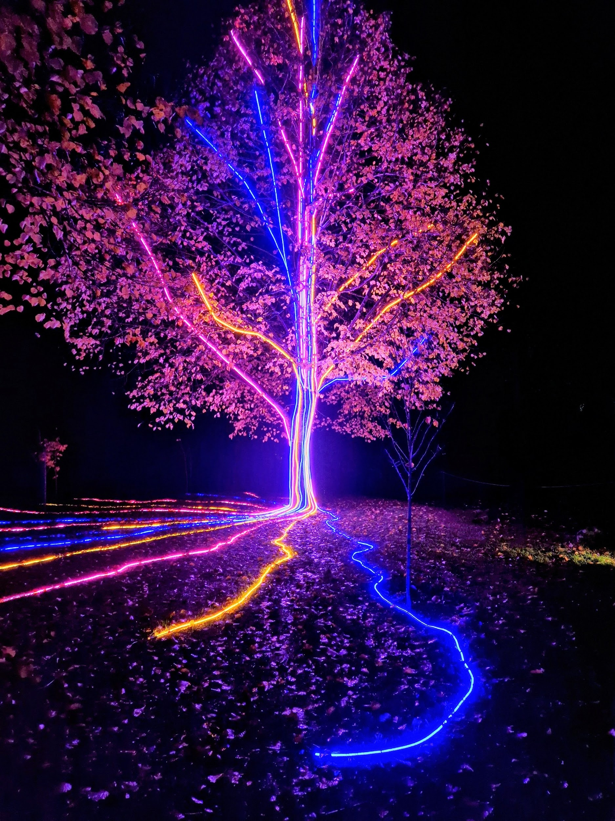
Storm Walker
Storm Walker
Symbolising, trust in Jesus Christ through life's storms.
Mark 4:35-41

Slide 9
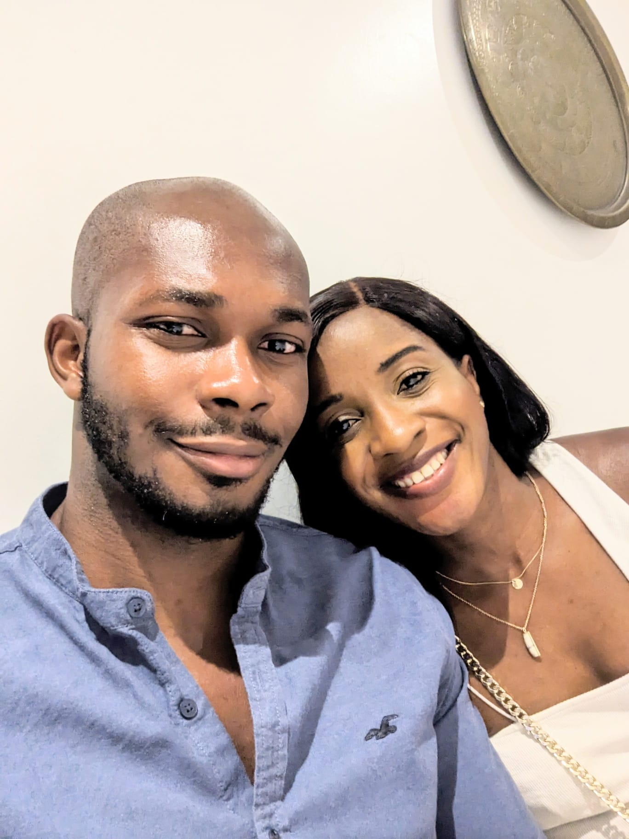
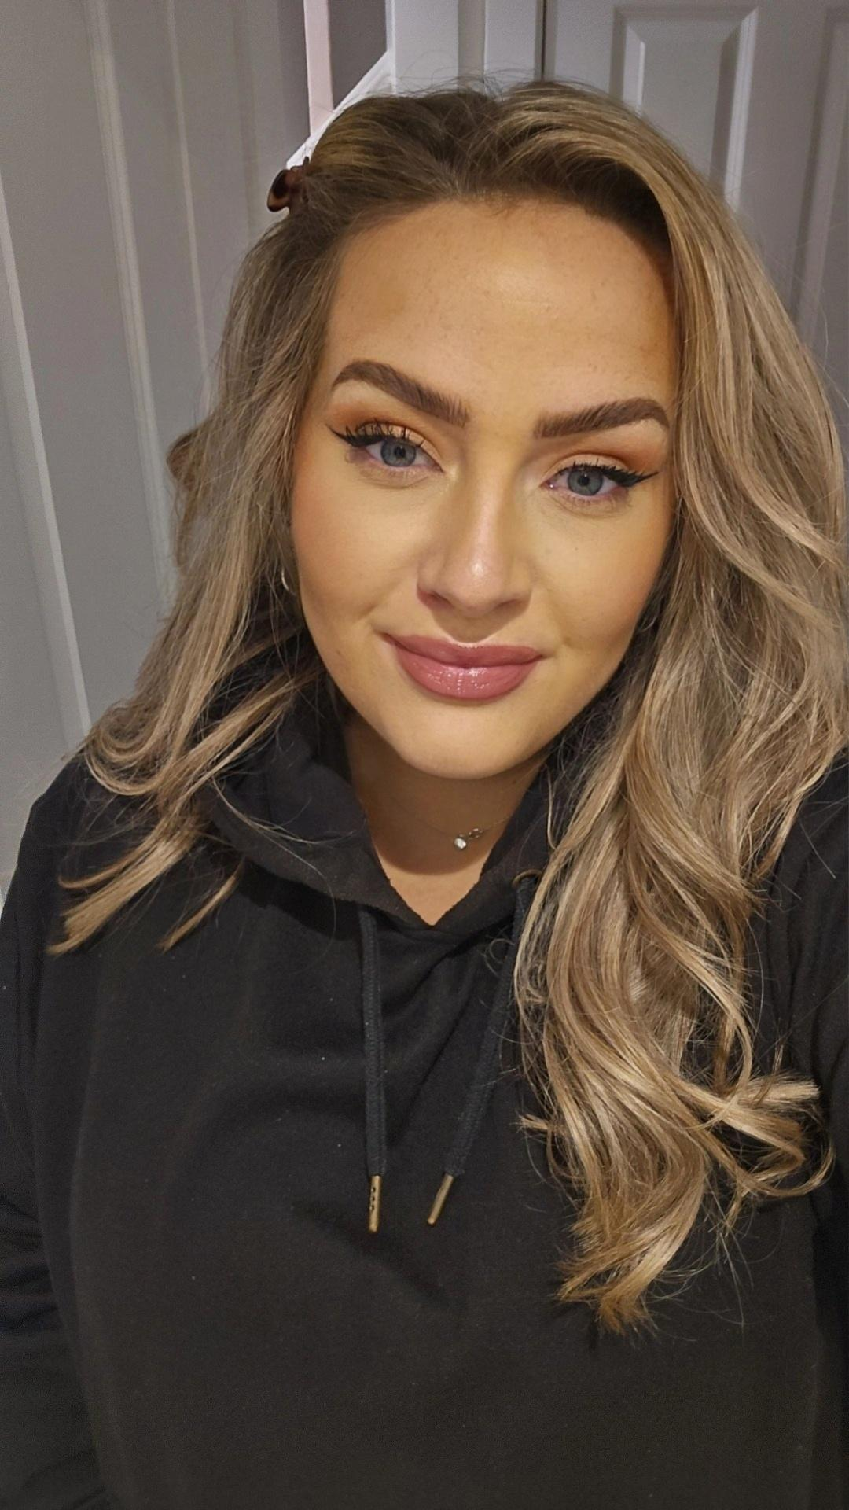
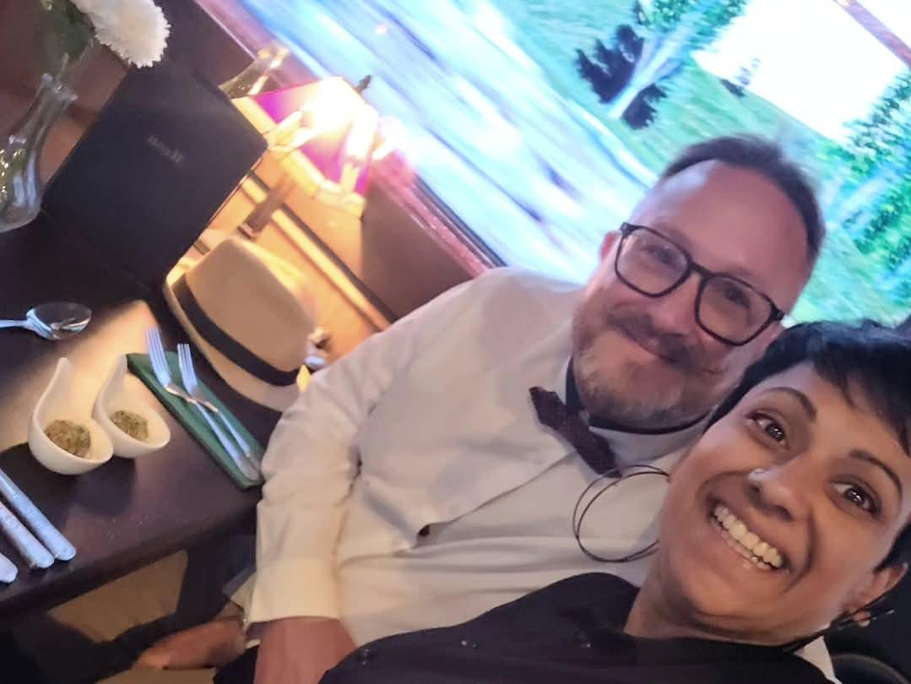
Group Leaders
Micheal and Mwamba
Wilfred and Parveen
Hannah

Slide 10
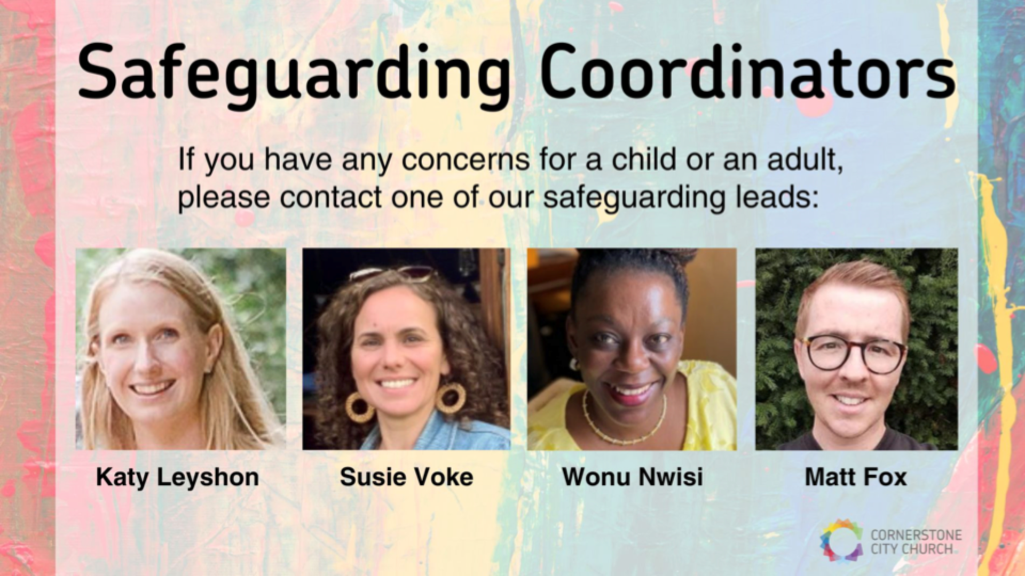

Slide 11


Slide 12
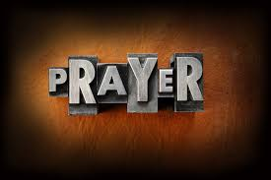

Slide 13
Thanksgiving
CCLI Song # 7199589
Nick Herbert | Taku Mudere | Zo Chilengwe
© Capitol CMG Genesis; Safe and Sound Music; Remaining portion is unaffiliated
For use solely with the SongSelect® Terms of Use. All rights reserved. www.ccli.com
CCLI Licence No. 33265

Slide 14
1/8
Enter in (Enter in)
His courts with praise (His courts with praise)
For He is greatly (He is greatly)
To be praised

Slide 15
2/8
What shall we do
We shall lift up a shout
What shall we do
We shall praise Him
What shall we do
For our God made a way
We'll give Him our thanksgiving

Slide 16
3/8
Magnify (Magnify)
His Holy Name (His Holy Name)
For He is greatly (For He is greatly)
To be praised

Slide 17
4/8
What shall we do
We shall lift up a shout
What shall we do
We shall praise Him
What shall we do
For our God made a way
We'll give Him our thanksgiving

Slide 18
5/8
Even if the rocks cry out
We're gonna drown them out
With a louder shout of praise
Even when the battles roar
We're gonna praise You Lord
'Cause You are always worthy

Slide 19
6/8
You are worthy
Worthy of honour and praise
You are worthy
We'll sing it again and again

Slide 20
7/8
What shall we do
We shall lift up a shout
What shall we do
We shall praise Him
What shall we do
For our God made a way
We'll give Him our thanksgiving

Slide 21
8/8
We'll give Him our thanksgiving
We'll give Him our thanksgiving

Slide 22
Gratitude
CCLI Song # 7158417
Benjamin Hastings | Brandon Lake | Dante Bowe
© 2019 SHOUT! Music Publishing Australia; Bethel Music Publishing; Bethel Worship Publishing; Brandon Lake Music; Maverick City Publishing; Maverick City Publishing Worldwide
For use solely with the SongSelect® Terms of Use. All rights reserved. www.ccli.com
CCLI Licence No. 33265

Slide 23
1/7
All my words fall short
I got nothing new
How could I express
All my gratitude

Slide 24
2/7
I could sing these songs
As I often do
But every song must end
And You never do

Slide 25
3/7
So I throw up my hands
And praise You again and again
‘Cause all that I have is a hallelujah hallelujah
And I know it’s not much
But I’ve nothing else fit for a king
Except for a heart singing hallelujah
Hallelujah

Slide 26
4/7
I’ve got one response
I’ve got just one move
With my arms stretched wide
I will worship You

Slide 27
5/7
So I throw up my hands
And praise You again and again
‘Cause all that I have is a hallelujah hallelujah
And I know it’s not much
But I’ve nothing else fit for a king
Except for a heart singing hallelujah
Hallelujah

Slide 28
6/7
Come on my soul
Oh don’t you get shy on me
Lift up your song
‘Cause you’ve got a lion inside of those lungs
Get up and praise the Lord (REPEAT)

Slide 29
7/7
So I throw up my hands
And praise You again and again
‘Cause all that I have is a hallelujah hallelujah
And I know it’s not much
But I’ve nothing else fit for a king
Except for a heart singing hallelujah
Hallelujah

Slide 31
Good Good Father
CCLI Song # 7036612
Anthony Brown | Pat Barrett
© 2014 Capitol CMG Paragon (Admin. by Capitol CMG Publishing)
Common Hymnal Digital (Admin. by Capitol CMG Publishing)
Housefires Sounds (Admin. by Capitol CMG Publishing)
Rising Springs Music (Admin. by Capitol CMG Publishing)
Tony Brown Publishing Designee (Admin. by Capitol CMG Publishing)
Vamos Publishing (Admin. by Capitol CMG Publishing)
worshiptogether.com songs (Admin. by Capitol CMG Publishing)
For use solely with the SongSelect® Terms of Use. All rights reserved. www.ccli.com
CCLI Licence No. 33265

Slide 32
1/7
I've heard a thousand stories
Of what they think You’re like
But I've heard the tender whisper
Of love in the dead of night
You tell me that You’re pleased
And that I'm never alone

Slide 33
2/7
You're a Good Good Father
It's who You are
It's who You are
It's who You are
And I'm loved by You
It's who I am
It's who I am
It's who I am

Slide 34
3/7
I've seen many searching for answers
Far and wide
But I know we're all searching for answers
Only You provide
Because You know just what we need
Before we say a word

Slide 35
4/7
You're a Good Good Father
It's who You are
It's who You are
It's who You are
And I'm loved by You
It's who I am
It's who I am
It's who I am

Slide 36
5/7
You are perfect in all of Your ways
You are perfect in all of Your ways
You are perfect in all of Your ways to us

Slide 37
6/7
Love so undeniable I can hardly speak
Peace so unexplainable I can hardly think
As You call me deeper still
As You call me deeper still
As You call me deeper still
Into love love love

Slide 38
7/7
You're a Good Good Father
It's who You are
It's who You are
It's who You are
And I'm loved by You
It's who I am
It's who I am
It's who I am

Slide 40
I Love You Lord (To My King)
Gatherhouse Music, Ryan Kennedy, Durell Comedy

Slide 41
1/8
You invite me
To sit down at Your table
Where I can taste and I can see
That You are good
and You are always faithful
To welcome me
The least of these

Slide 42
2/8
You bring beauty out of the ashes
To restore and to redeem
So I have come to pour out all my oil
All I have, this offering

Slide 43
3/8
I love You Lord, I love You
I want to sing a sweet, sweet melody
To tell You, that I love You
Oh let it be a sweet, sweet melody (REPEAT)
To my King

Slide 44
4/8
You inhabit the praises of Your people
So I know You're here, right now
With Your Spirit stirring all around me
Before Your glory, I bow

Slide 45
5/8
I love You Lord, I love You
I want to sing a sweet sweet melody
To tell You, that I love You
Oh let it be a sweet sweet melody (REPEAT)
To my King

Slide 46
6/8
In my coming and my going
I will praise You
From the evening through the morning
I will praise You
And when I rise and when I fall
I will praise You through it all
And I will sing a love song to my King

Slide 47
7/8
When I'm lonely and I'm doubting
I will praise You
On the mountain when I'm shouting
I will praise You
And when I rise and when I fall
I will praise You through it all
And I will sing a love song to my King

Slide 48
8/8
I love You Lord, I love You
I want to sing a sweet sweet melody
To tell You, that I love You
Oh let it be a sweet sweet melody (REPEAT)
To my King

Slide 49
1/1
I love You Lord
And I lift my voice
To worship You
O my soul rejoice
Take joy my King
In what You hear
May it be a sweet, sweet sound
In Your ear

Slide 50
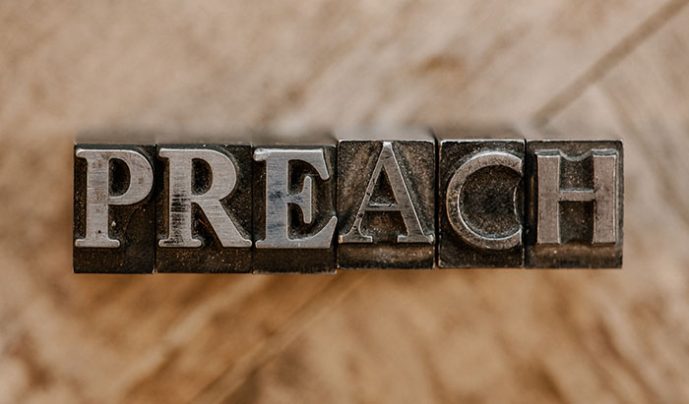

Slide 51
2 Corinthians 14 May the grace of the Lord Jesus Christ, and the love of God, and the fellowship of the Holy Spirit be with you all
Surely goodness and mercy shall follow me all the days of my life, and I shall dwell in the house of the Lord forever.

